Slide 1
The Academy of Board Certified Environmental Professionals
Certifying qualified professionals, upholding ethical standards and technical practices, and supporting the environmental practice since 1979
www.abcep.org

Slide 2
Agenda
Who Are We?
What Do We Do?
What Makes Us Different?
Benefits of Being a CEP
Becoming a CEP
Becoming a CEP-IT

Slide 3
Who Are We?
Mid- and senior-level professionals dedicated to serving the environmental professional community
Members of a worldwide network representing the environmental professional spectrum of services
Committed to exemplary ethical standards
Consistent in promoting and advancing the profession’s technical standards
Notes:
Initiated in 1979 in response to an identified need for interdisciplinary certification in the environmental field.

Slide 4
Who Are We?
Our primary mission is to confer the Certified Environmental Professional credential to meritorious professionals demonstrating exemplary standards of ethics and technical practice.
www.abcep.org/about
Notes:
Our Board of Trustees manage the ABCEP operations
The Certification Review Board evaluates applications for conferring the CEP credential
Our 501 C (6) Organization status requires all earnings to be directed back into the organization to further its mission.
We do this by working to improve the business conditions of our members through promoting the professional standard of care demonstrated by CEPs, working with governmental agencies or organizations to recognize and value CEP notation in competitive bid processes.
ABCEP is accredited by the Council of Engineering and Scientific Specialty Boards (CESB) which requires that we “use procedures that assure relevance of the knowledge, skills, and abilities that define the body of knowledge of the certification scope.”
The purposes of ABCEP are detailed on our website.

Slide 5
What Do We Do?
Confer the CEP and CEP-IT credentials through:
Peer review of experience & technical acumen
Annual review of maintenance hours (CEU-like)
Maintain third-party accreditation
Require members to stay current on technical practices and industry engagement
Provide and maintain a body of knowledge
Facilitate professional networking and info-sharing
Provide mentors for CEP applicants & CEP-ITs
Notes:
- Our annual maintenance requirements demonstrate a commitment by our members to stay informed and engaged in the environmental professional industry
Our collective knowledge is one of our greatest assets. We host and promote networking events through online platforms – make sure you’re on our mailing list for news about upcoming “Networking Happy Hour” events – and engage with regional and national environmental conferences (hosting in-person events and booths at NAEP, chapter gatherings, etc.)
ABCEP contributes to the U.S. Department of Labor career definition and advancement pathways for environmental career and for military service members transitioning to civil service
ABCEP participates in working groups for consistent credentialing standards (ASTM and CESB)

Slide 6
What Makes Us Different?
Commitment to a consistent standard of professional ethics across the spectrum of environmental practice
Dedication to staying informed of evolving environmental practice, technologies, and regulations
Peer-reviewed application process
Mentoring program
Third-party accredited
Notes:
Interdisciplinary organization that promotes ethical standards and commitment to continuing education and knowledge above specific technical disciplines such as a PWS or CHHM
ABCEP’s Code of Ethics and Standards of Practice for Environmental Professionals, to which CEPs are required to adhere, has been recognized in U.S. Federal Court as representing the professional standard of ethical practice to which environmental professionals may be expected to adhere whether or not they are members of the Academy.

Slide 7
Benefits of Being a CEP
Enhance your professional reputation
Enhances networking options and marketability
Focuses professional development
Provides advantage in proposals
Demonstrates professional level of care
Demonstrates a reliable source for competent consultants & colleagues
Opens engagement opportunities
Notes:
For individuals, being a CEP
opens networking opportunities through our membership, members-only website, operational committees, and CRB
Demonstrates your commitment to high standards of ethics and technical practice through use of CEP stamp
Gives a personal sense of achievement
Many employers offer incentive programs acknowledging the CEP credential
For employers and clients, having CEPs on staff
Reduces professional liability costs
Differentiates your team from the competition using the CEP and all it stands for
Provides credibility to the client and to the b
Enhances confidence in employees knowing they are proficient in knowledge, skills, and abilities
Engagement opportunities include
- Participate at annual meetings
- Support environmental training
- Peer recognition:
Dr. Richard J. Kramer, CEP Memorial Award for Environmental Excellence
President’s Leadership Award
Emerging Young Environmental Professional Achievement Award

Slide 8
Benefits of Being a CEP-IT
Pathway to CEP
Mentor & Career Plan
Participation can reduce required professional experience years for CEP application eligibility
Enhances networking options and marketability
Focuses professional development
Demonstrates professional level of care
Opens engagement opportunities
Notes:
For individuals, being a CEP
opens networking opportunities through our membership, members-only website, operational committees, and CRB
Demonstrates your commitment to high standards of ethics and technical practice through use of CEP stamp
Gives a personal sense of achievement
Many employers offer incentive programs acknowledging the CEP credential
For employers and clients, having CEPs on staff
Reduces professional liability costs
Differentiates your team from the competition using the CEP and all it stands for
Provides credibility to the client and to the b
Enhances confidence in employees knowing they are proficient in knowledge, skills, and abilities
Engagement opportunities include
- Participate at annual meetings
- Support environmental training
- Peer recognition:
Dr. Richard J. Kramer, CEP Memorial Award for Environmental Excellence
President’s Leadership Award
Emerging Young Environmental Professional Achievement Award

Slide 9
Recognition of the CEP credential
Employers – career advancement threshold
Private, public, and military
Entities
ASTM – exceeds Environmental Professional rqmts
District Court – recognized as expert witness
Universities – meets lecturer requirements
Agencies
Increasing number of CEP required citations in specifications and solicitations at Federal and State levels – US Coast Guard example
Notes:
Update as more info available

Slide 10
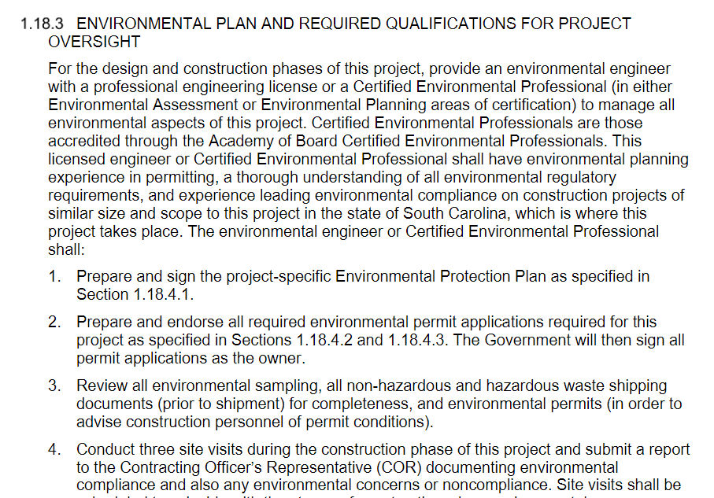
Recognition of the CEP credential

Slide 11
Pathway to be a CEP
CEP In-Training (CEP-IT)
CEP
By essays
By eminence
WWW.ABCEP.ORG – CEP vs. CEP-IT
CEP v CEP-IT - Academy of Board Certified Environmental Professionals (abcep.org)

Slide 12
Becoming a CEP-IT
Prepares applicants pursuing advancement in the environmental profession
Typically conferred to early- to mid-level professionals
Often conferred to future CEPs as they accrue years in positions of responsible charge or supervision
ABCEP-assigned mentor
Reduced requirements from CEP-IT to CEP
Notes:
Responsible charge:
The direction of environmental work by an environmental professional (you) to the extent that successful completion of the work is dependent on your decisions made without advice or approval of others.
Responsible supervision: the supervision of another professional person's work by an environmental professional (you) to the extent that you assume the professional responsibility for the work.
Mentors support CEP-ITs and act as a point of contact during their application process. The mentor's role is to be there for these individuals and to answer questions throughout the process. The CEP-IT may contact the mentor as needed to discuss progress, to solicit feedback regarding the CEP-ITs career, and to obtain suggested opportunities for growth.
Mentors may provide reviews of draft essays but may not coach; mentors are excluded from the CEP application review panel.
CEP-IT for 3 years = CEP requirements for total experience are reduced by 1 year. Does not reduce minimum number of years in a position of responsible charge/supervison.

Slide 13
Becoming a CEP by Essay
Certification is offered in six functional areas representing expanse of the environmental field.
Awarded to mid- and senior-level professionals following review of application, background, experience, letters of reference, essays, and interview.
Mentors are available to support CEP candidates throughout process
Notes:
Functional areas: refer to website or add notes for specific audiences
(Assessment, Documentation, Operations, Planning, Research & Education, Sustainability)
Applicants must sign Code of Ethics.
4 letters of reference required.
The essay questions are designed to test your communication skills, knowledge, and technical experience; they must be fully developed and demonstrate you understand the body of knowledge.
2 required essays: Keeping Current and Ethics
3 essays of your choice from your selected Functional Area
Applications reviewed by 7 members of the CRB, who will review and determine the applicant’s qualifications.
Mentors can help you understand the application but cannot coach you on completing it.

Slide 14
Becoming a CEP by Eminence
CEP by Eminence
Possession of a Bachelor’s or advanced degree.
At least 20 years of experience as an environmental professional.
At least 15 years of responsible charge and/or responsible supervision.
Achievement of a leadership position within their organization.
Must demonstrate a record of service to the profession
Notes:
Recognizes environmental professionals who have accomplished significant achievements over the course of their advanced career.
For those select individuals who demonstrate their unique qualifications and more importantly, contributions back into the environmental profession.
Demonstrates that they "give back" to the environmental profession as demonstrated by a portfolio of their accomplishments.
Essay requirements are waived.
Note, CEP by Eminence is a very high standard to meet. This is a portfolio-based evaluation.

Slide 15
Credentialing Options
Requirement: | CEP-IT | CEP | CEP by Eminence
Application Fee | $75.00 | $250.00 | $250.00
Certification Fee | $75.00 | $250.00 | $250.00
Diploma / Transcripts | ✓ | ✓ | ✓
Reference Letters | 2 | 4 | 6
Essay Questions | No | 5 | 2
Mentor Assigned | ✓ | Optional | No
Years of Experience* | 1-5 | 9 | 20
Years in Responsible Charge or Supervision | N/A | 5 | 15
*Masters Degree = 1 Year Experience Substitution PhD = 2 Years’ Experience Substitution
Notes:
Degrees claimed must be from a fully accredited college or university
No substitution for the required years in responsible charge and/or responsible supervision.

Slide 16
Application submittal and review process
Start an application online! www.abcep.org
Submit supporting documents
Transcripts and Reference Letters are submitted by institution / author
For CEP-IT: Executive Administrator reviews
For CEP: Seven-member Peer-review panel is assigned, and you’ll be contacted for interview
Review panel makes decision!
Annual maintenance hours and fees are required to remain in good-standing
Typical application process: 3 months

Slide 17
ABCEP Information
For further information, visit:
www.abcep.org
Andrea Bower
Executive Administrator
office@abcep.org or 866-767-8073

